Slide 1
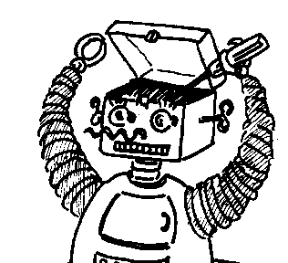
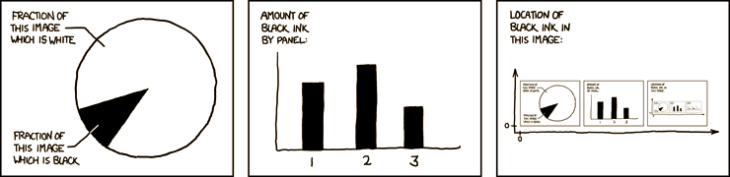

Maryland Metacognition Seminar
http://xkcd.com/
Communicative Agents for Spatio-Temporal Reasoning
Kalyan Gupta
Knexus Research Corp., National Harbor, MD
27 January 2011, 12:00 PM
A. V. Williams Bldg., Rm. 3258, College Park
Abstract:
Multimodal communication is a critical requirement for autonomous agents, both physical and virtual. Development and evaluation of agents that interact in natural language and gestures with human operators reveals challenging problems at the intersection of linguistic phenomena such as underspecification and sense extension with world knowledge and pragmatics. I will describe our approaches for exploring these issues through spatio-temporal reasoning tasks such as object placement and landmark selection. I will also describe a test bed called coaster that we are developing for evaluating our approaches. My description will include coaster agent’s cognition and potential opportunities for developing its meta-cognitive abilities.

